Slide 1



TEAM Neptune
Wael Farah, Colin Jacobs, SRDAN Kotus,
Themiya nanayakkara, Vivek Venkatraman Krishnan

Slide 2
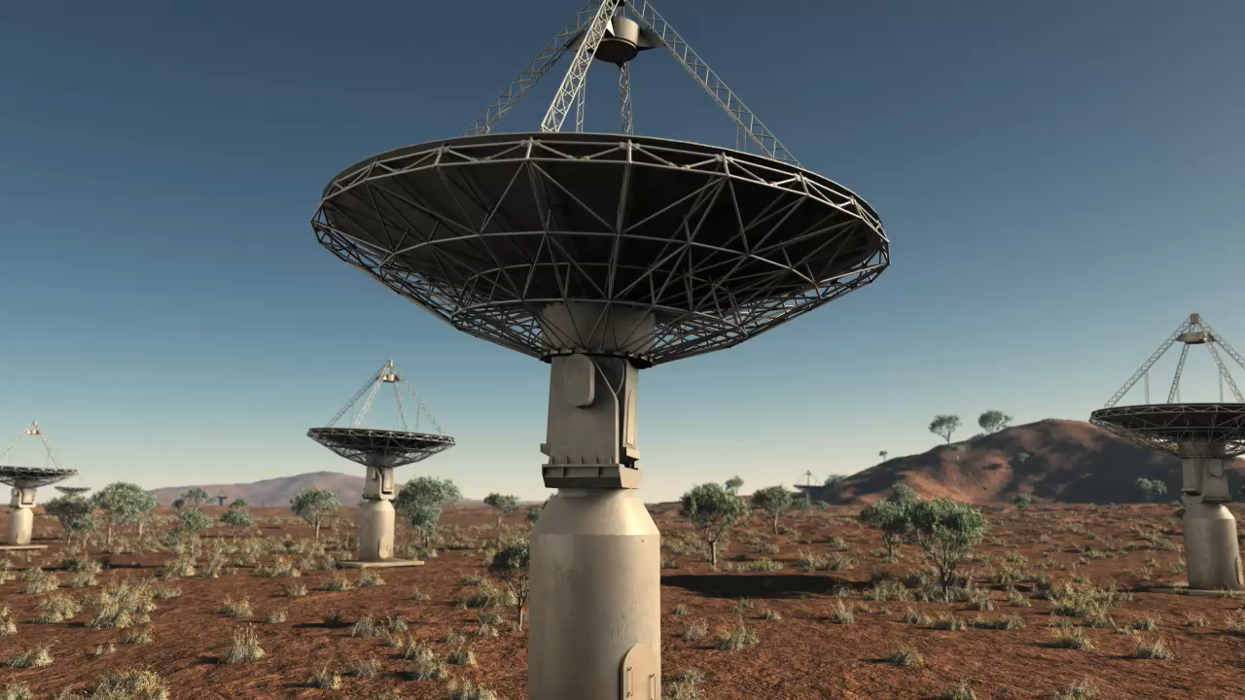
ASTRO = BIG DATA

Slide 3
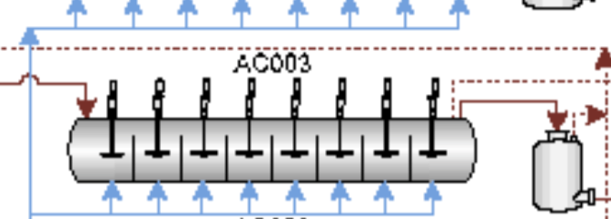
LIHIR AUTOCLAVE CHALLENGE
Conditions

Slide 4
What we have: Data
What we want: Change
Internal sensor network, outputs every 5 minutes
(2048 columns!)
12 months of data
Metrics to measure performance
New insights into the operation of these systems
A way to action this understanding

Slide 5
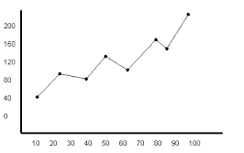
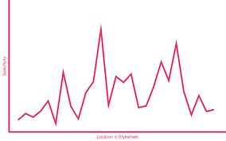
modeling
A
B
A
B
C
D
C
D

Slide 6
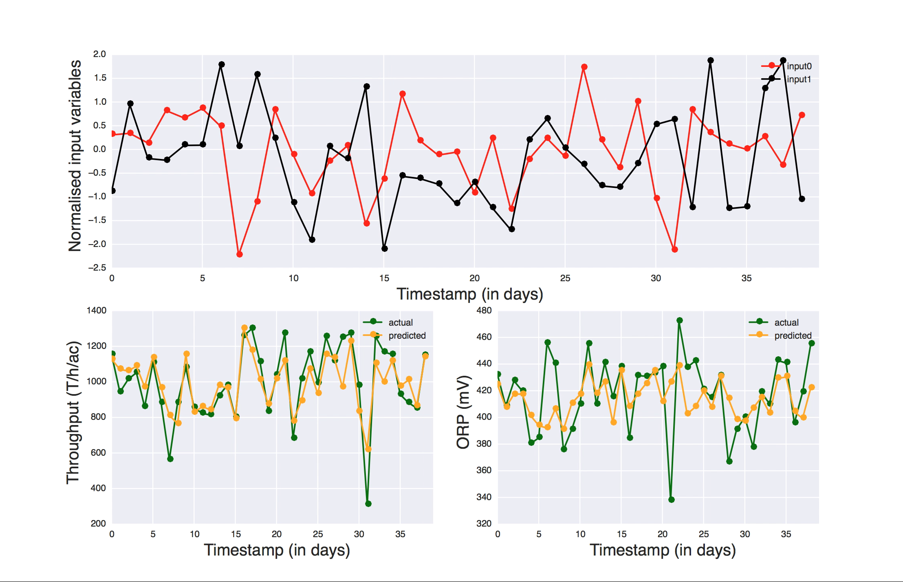
Building A model

Slide 7
IMPLEMENTATION
Monitor performance
Model spots mistakes and suggests changes
Improve the model by learning from continued operations

Slide 8
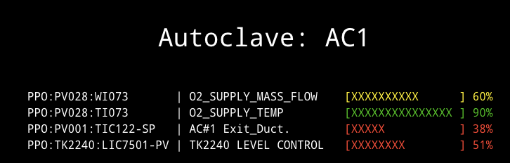
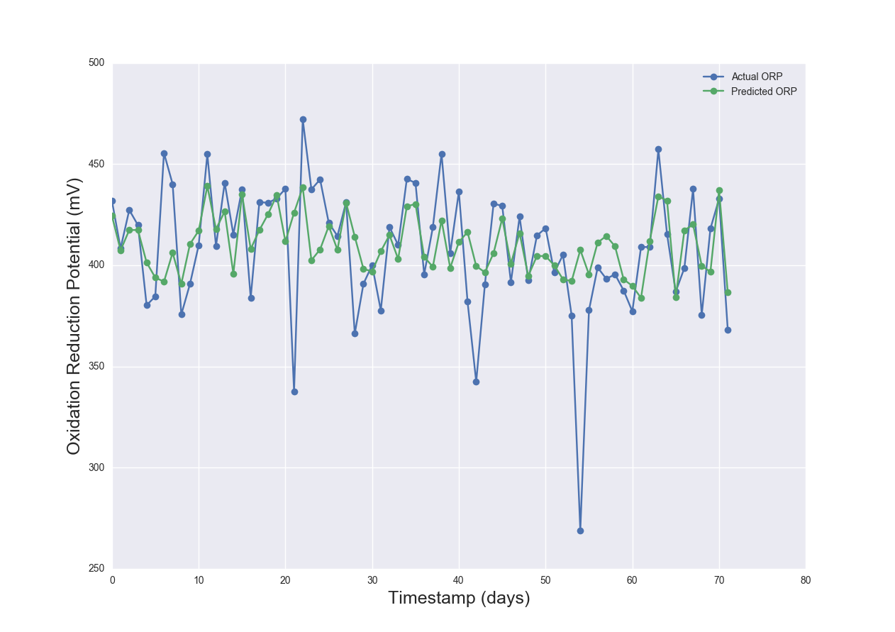
DEPLOYMENT

Slide 9
Next steps
Explore model in detail
Find low-hanging fruit
Build deployable tool

Slide 10
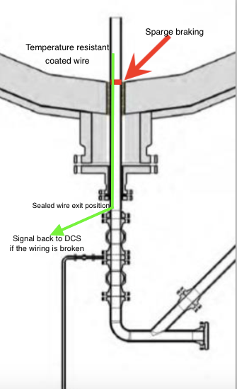
Sparge challenge

